Slide 1
Flight delay prediction based on machine learning
Jun Chen
Shuai Liu

Slide 2
Overview
Introduction
Objectives
Data Summary
Exploratory Data Analysis
Experimental Setup
Results
Conclusion

Slide 3
Introduction
Nearly every airline passenger has experienced the uncertainty and stress associated flight delays. On a regular basis, the national media highlights the growing trend of flight delays and the impact these delays pose for the travelling public.
Almost half of all flight delays and cancellations are caused by poor weather. While weather may only minimally impact other modes of transportation, it is the single most prevalent cause of flight delays.
KnowDelay™, it is a technology-based service that accurately predicts weather-related delays up to five days in advance of travel and identifies alternative itineraries that are less likely to be delayed.
Company research has shown that the likelihood of a passenger delay during poor weather can be reduced from over 50 percent to approximately 15 percent with the use of KnowDelay.
The raw dataset is from KnowDelay.

Slide 4
Objective
Perform statistical analysis and generate a probabilistic model for itineraries and associated alternatives.
An objective of the project is defined as 80 percent accuracy for airport delays over thirty minutes, meaning the algorithm predicts delays with approximately 80 percent accuracy. The measure we will deploy to capture such accuracy is mean absolute percentage error (MAPE) and our objective is a final MAPE measure of 20 percent or less.

Slide 5
Exploratory Data Analysis
Basic statistic for weather and delay for airport Atl.

Slide 6
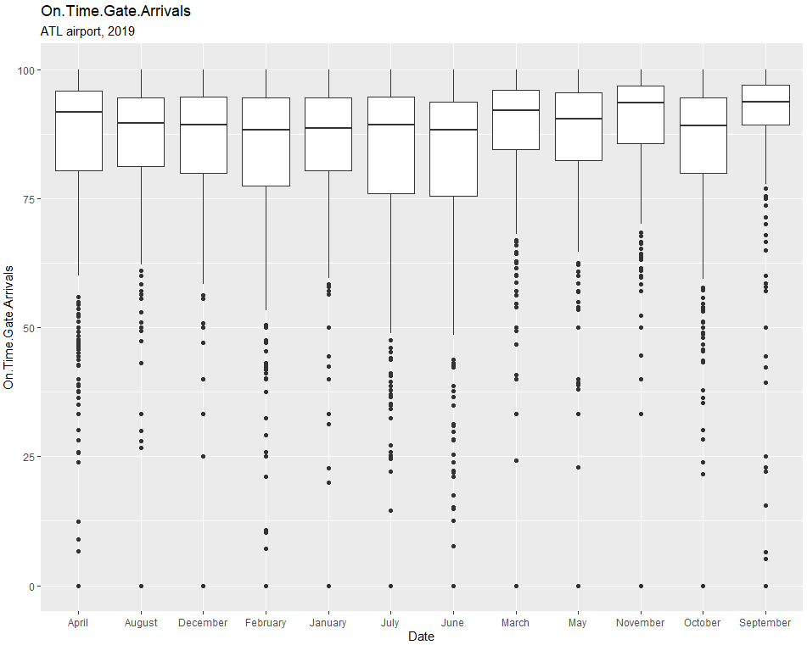
On time gate arrival distribution by month

Slide 7
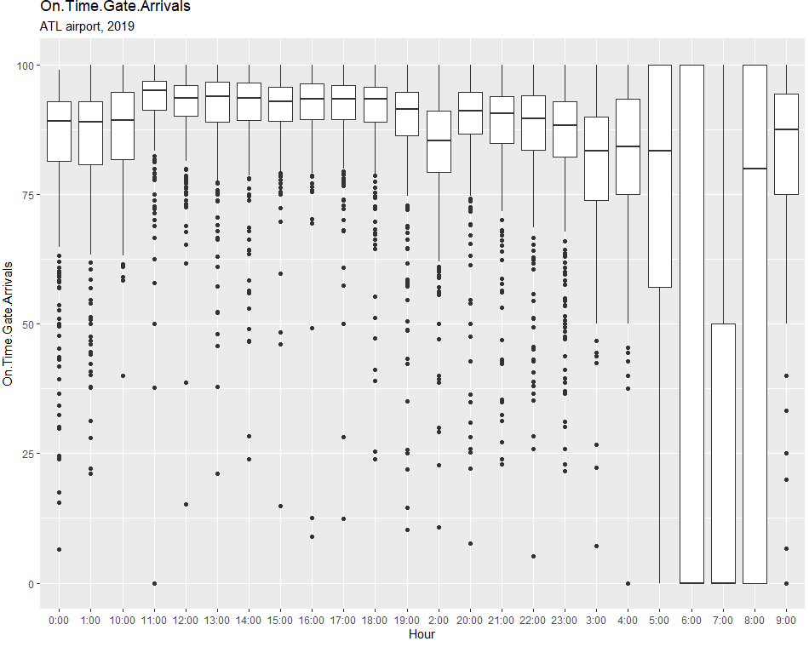
On Time Gate Arrivals by Hour

Slide 8
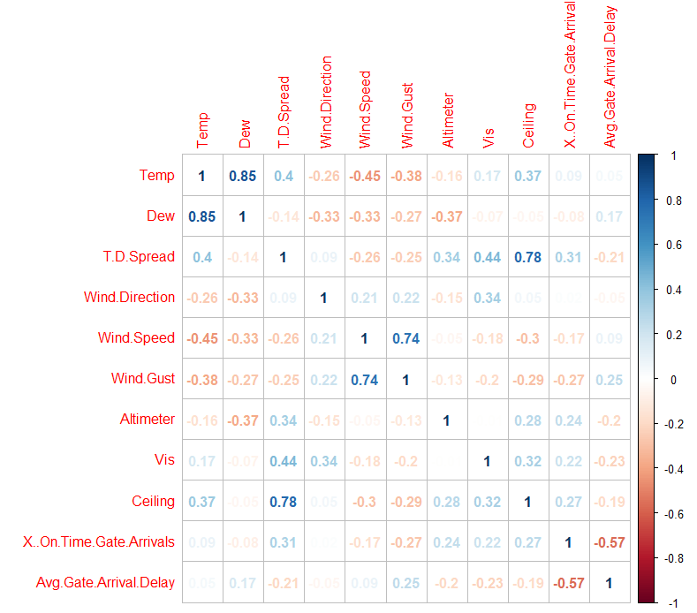
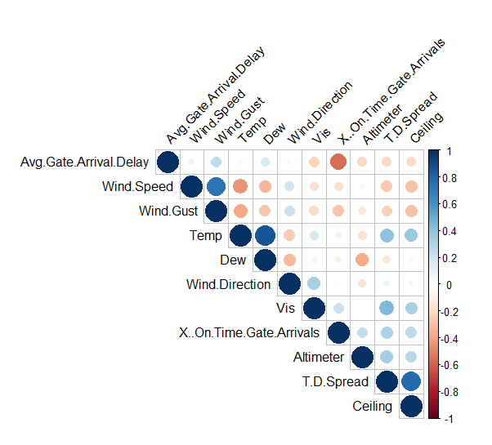
The correlation between weather and delay

Slide 9

Experimental Setup
Three stages
Data summary and processing (ETL process) using Linux on Local Docker environment (1 terabyte space, 16 GB RAM, and 8 processors, 6 GB GPU).
Modeling and Cross Validation (Modeling) on a local cluster (1 terabyte space, 16 GB RAM, and 8 processors, 6 GB GPUs).
Prediction using several machine learning methods on a local cluster (1 terabyte space, 16 GB RAM, and 8 processors, 6 GB GPUs).
Data output in the first stage is then used as feature input for the model training in the second stage. We also used Python and packages such as Pandas and Scikit-learn for efficient model testing, hyperparameter tuning and model evaluation.
The dataset will be split into 70% training set and 30% test set. Hyperparameter tuning was done on 5-fold CV of the training set and the final evaluation of model performance was done on the test set.

Slide 10
machine learning models
EXtreme Gradient Boosting (XGBoost) is a machine learning technique.
As an open source package, XGBoost has been widely recognized in a number of machine learning and data mining challenges.
17 solutions used XGBoost among the 29 challenge winning solutions published at Kaggle’s blog in 2015 and the top-10 winning teams used XGBoost in KD
Multiple machine learning models (Random Forest, Logistic Regression, GradientBoost, AdaBoost, GaussianNB, KNN, MLP) in the study were evaluated with XGBoost.

Slide 11
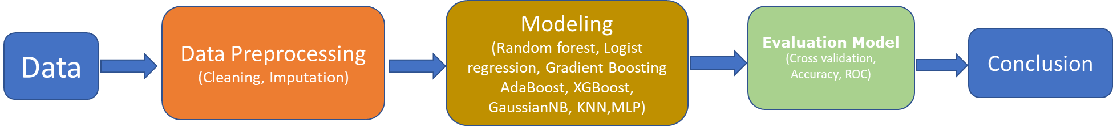
Methodology Flowchart

Slide 12
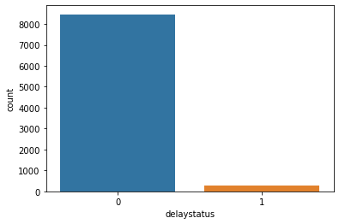
The delay status distribution
Synthetic Minority Oversampling Technique (SMOTE) is a very popular oversampling method that was proposed to improve random oversampling with low-dimensional data. So, we will apply SMOTE (Synthetic Minority Oversampling Technique) to oversample the dataset and then the models can learn more efficiently

Slide 13
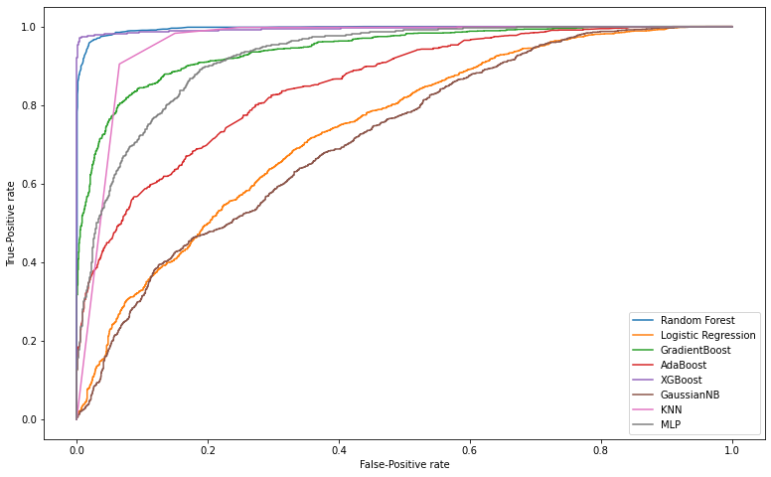
roC Curve (all variables)
Notes:
'Temp','Dew','T.D.Spread','Wind.Direction','Altimeter','Wind.Speed','Wind.Gust','Vis','Ceiling'

Slide 14
Cross validation accuracy (all variables)

Slide 15
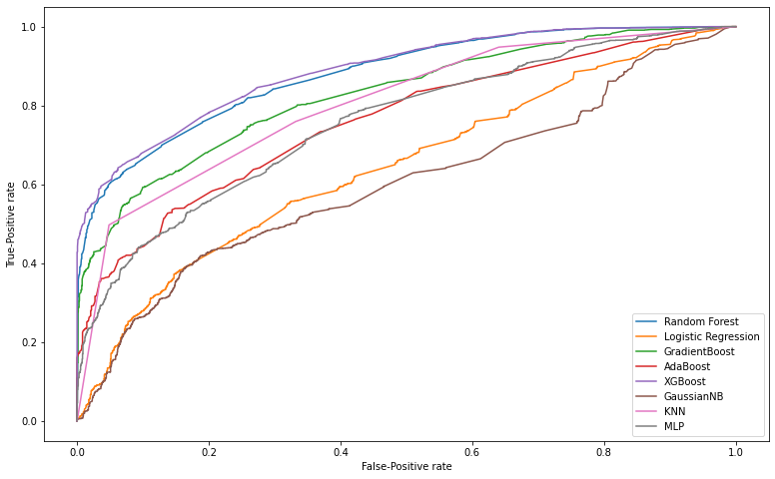
ROC curve (only four variable)
Notes:
'Wind.Speed','Wind.Gust','Vis','Ceiling'

Slide 16
Cross validation accuracy (only four variables)

Slide 17
Conclusion and Next
Several machine learning models have been evaluated.
XGBoost has outperform the other methods based on all the criterions.
Using 9 variables can give high accuracy prediction.
Evaluate more datasets.

Slide 18
Thank you

Slide 19
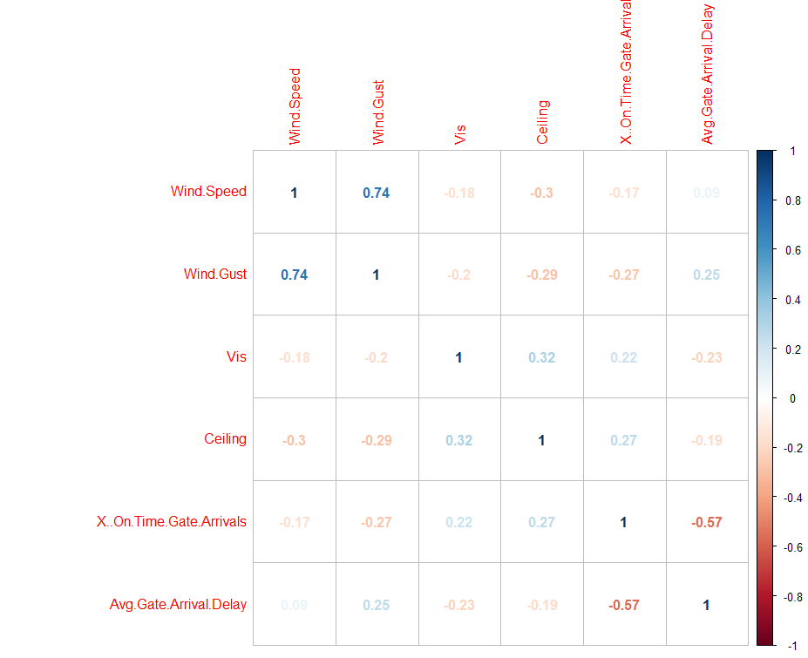
The correlation between weather and delay

Slide 20
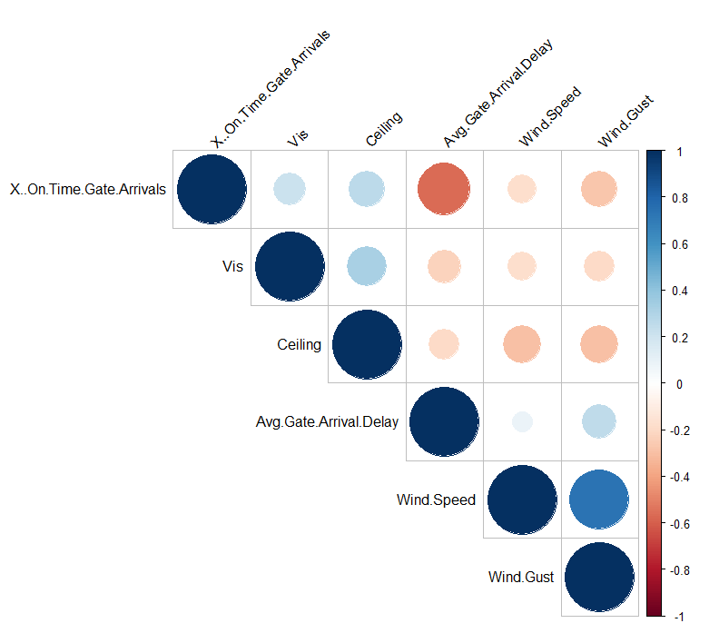
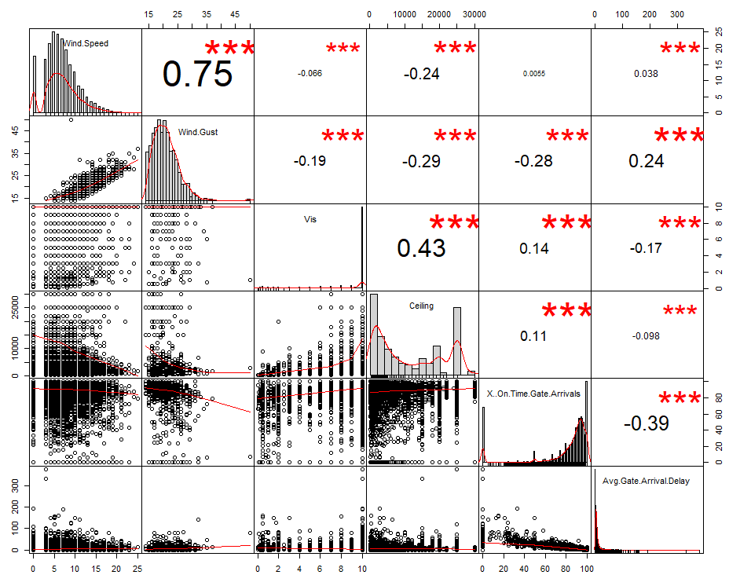
The correlation between weather and delay

